Slide 1
Implementing Enterprise GenAI Applications with Azure OpenAI

Slide 2
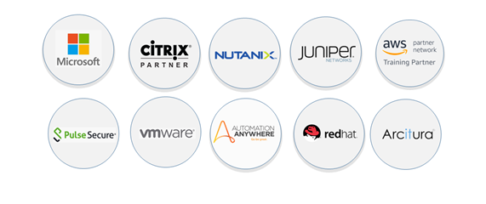
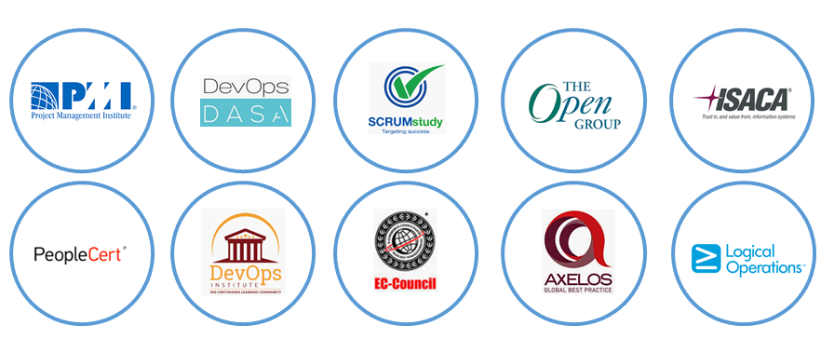


INTRODUCTION: Spectrum Networks – Company Overview

Training for Vendor Specific Courses
Training for Professional Certifications




Slide 3
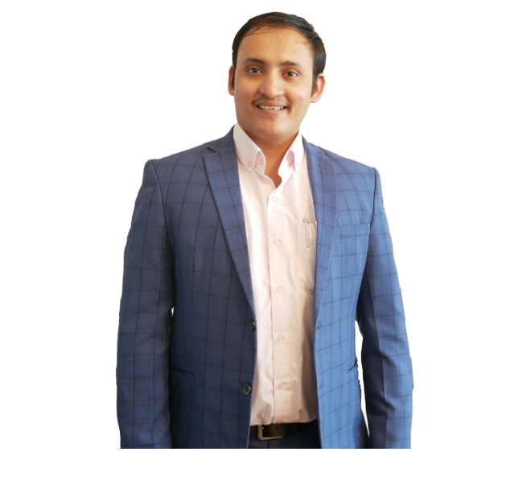
Hello!
Thank you for joining me today
Instructor: Anshu Pandey
AI Consultant & Microsoft Certified Trainer
12+ years of experience in enabling businesses with AI & Analytics engine from Telecom, Banking and Education.
linkedin.com/in/anshupandey

Slide 4
Let’s get to know each other
Your name
Title/function
Your experience with Azure, Python and AI
Your expectations for the course

Slide 5


Let’s have a great time together
We all contribute to a great class
Pre-requisites
Ask questions: as many as possible
Keep your questions relevant to the topic of the day
If you have any interesting questions but is less relevant to the topic being discussed: park it for the end of session.
Perform hands-on activities.
Be on time (class hours)
Be present (avoid mail, calls, side meetings)
Experience with Microsoft Azure Cloud
Experience with Python Programming

Slide 6
About this course
What we’ll cover
In this course, you will learn how to implement generative AI solutions by using Microsoft Azure OpenAI Service. Specifically, you’ll learn how to:
Provision Azure OpenAI resources and deploy OpenAI models for generative AI tasks
Use APIs and SDKs to consume models from client applications
Apply prompt engineering to generate relevant results, generate code and images, and use your own data
Intended audience
The primary audience for this course is application developers seeking to include Azure OpenAI models in their applications.
Although Azure OpenAI models operate on natural language prompts, to use the APIs and SDKs effectively, a basic knowledge of Microsoft C# or Python is recommended.

Slide 7
Course schedule
 | Covreage
Early morning (09:30 to 11:00) | Integrating Tools with LLMs using openai SDK Understanding Agents v/s chains v/s LLMs Developing Agents with LLMs using Azure OpenAI and LangChain
Break (11:00 to 11:10)
Late morning (11:10 to 12:30) | Combine functions and prompts Integrating databases, external APIs and data with Azure OpenAI Developing RAG Solutions with Azure OpenAI and LangChain
Lunch (12:30 to 13:10)
Early afternoon (13:10 to 15:00) | Deploy DALLE model within Azure OpenAI Use Azure Dalle for image generation GPT4 Vision and multi modal applications
Break (15:00 to 15:10)
Late afternoon (15:10 to 16:30) | Responsible Generative AI Fine-tune a foundation model from the model catalogue in Azure Machine Learning (demo) Mini Project: Implement Financial Assistant Bot using RAG Approach Q&A

Slide 8
INTRODUCTION: Few Important Points to Note

You should have received the link to ebook via email.
Pls check email : palvinder.singh@specnt.com.
If not please email : palvinder.singh@specnt.com, we will share same over email.
If you face issue with ebook/codes etc , please email (palvinder.singh@specnt.com).
Let us keep the session interactive ☺




Slide 9
Azure training and certifications
Role-based
Technical skills required to perform a job
Specialty
Deep technical skills managing industry solutions
Apps & Infra
Data & AI
Azure Solutions Architect
(AZ- 303 & AZ 304)*
Azure for SAP Workloads (AZ- 120)
Expert
DevOps Engineer
(AZ- 400)
Azure Administrator
(AZ-104)
Azure Database Admin
(DP-300)*
Azure IoT Developer (AZ- 220)
Azure Developer
(AZ-204)
Azure Data Scientist
(DP-100)
Migrate SQL Workloads to Azure (DP-050)
Azure Security Engineer
(AZ-500)
Azure AI Engineer
(AI-102)
Associate
Migrate NoSQL Workloads to Azure Cosmos DB (DP-060)
Azure Data Engineer
(DP-200 & DP-201)
Data Analyst
(DA-100)
Migrate Open Source Data Workloads to Azure (DP-070)
Fundamentals
Foundational understanding of technology
Azure Fundamentals
(AZ-900)
Azure Data Fundamentals (DP-900)*
Migrate Application Workloads to Azure (WS-050)
Azure AI Fundamentals (AI-900) *
*In BETA
Last updated: June 2020
Notes:
This is our complete portfolio of training and certification for Azure,
These are the certifications we have released to meet market needs.
All our certifications prove that a person has the skills to help organizations maximize the capabilities of the cloud to achieve desired business outcomes.
We update our certifications regularly to reflect the change of pace of business and technology. Our certifications remain technically accurate and relevant, with updates occurring every two months, and additional roles and specialties added as the market requires.
So, how do you leverage all the resources available and set your team on a learning journey?
designed to meet industry and market needs, with roles, skills and capabilities needed for the job, including specializations, hands-on experience and practice requirements.

